Slide 1


Big Mountain Resort Pricing Analysis
Jason C. Jiang

Slide 2

The Problem at Hand
A new chair lift has pushed operation costs by $1,540,000. The objective now is to improve Big Mountain Resort’s pricing strategy to make up for the increase in operating costs for the upcoming season.

Slide 3

Proposed Solution:
Increase the Adult Weekend ticket prices from $81.00 → $91.00

Slide 4
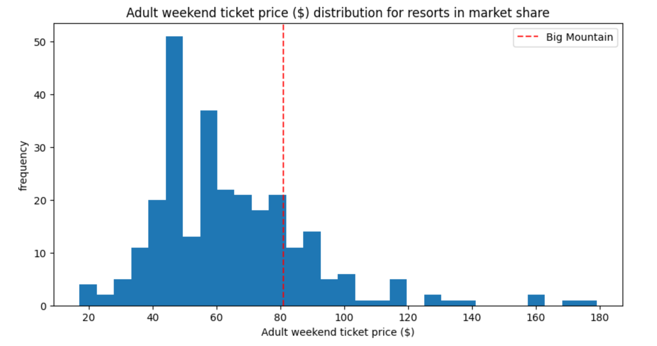
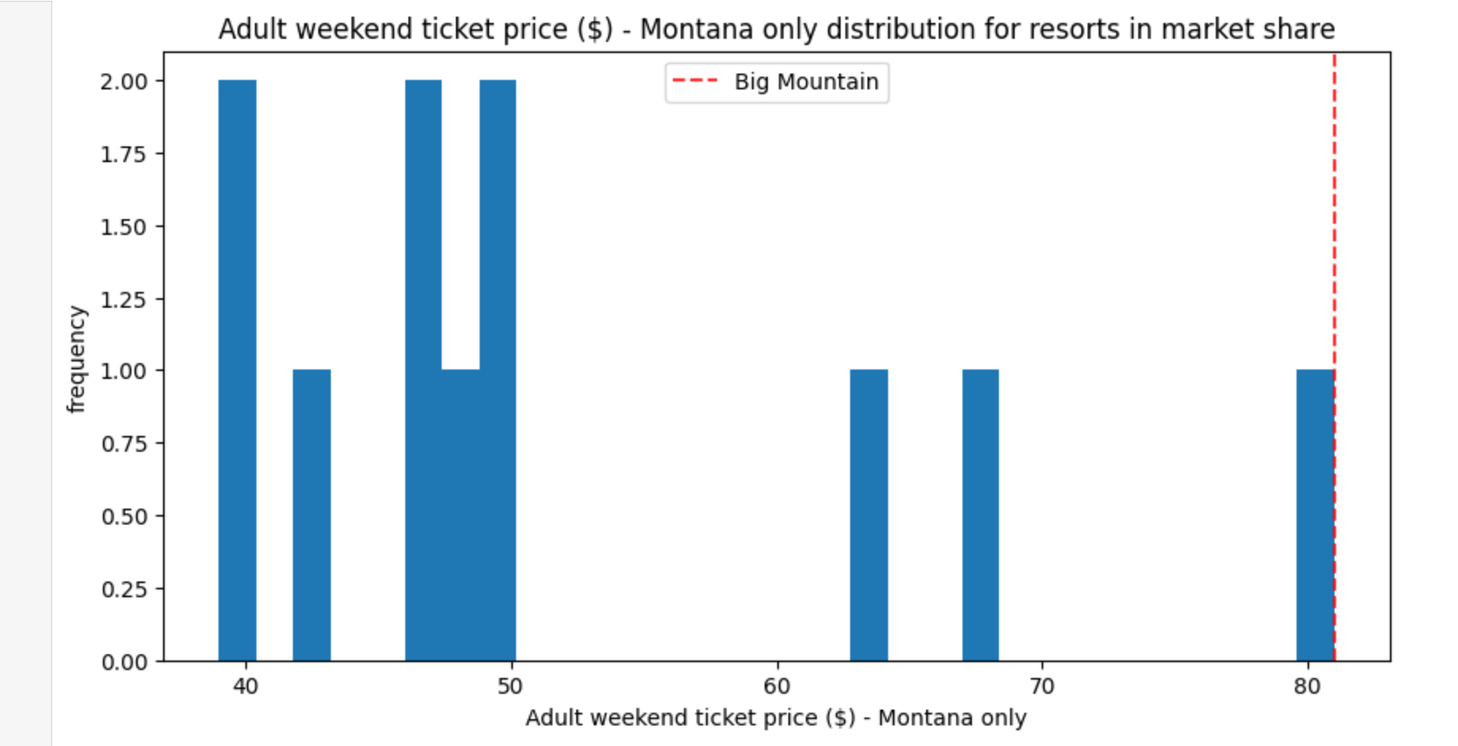
Ticket Price Comparison
A graph depicting adult ticket prices for all resorts in the US market
A graph depicting adult ticket prices for all resorts in Montana
Current prices show Big Mountain above the mean of all US resorts and the upper end of all Montana resorts.

Slide 5
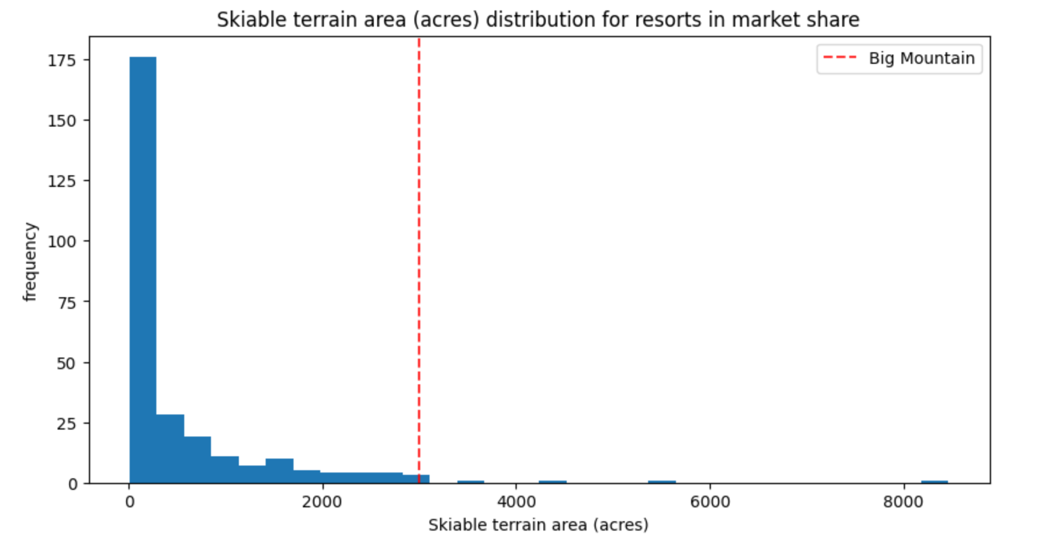
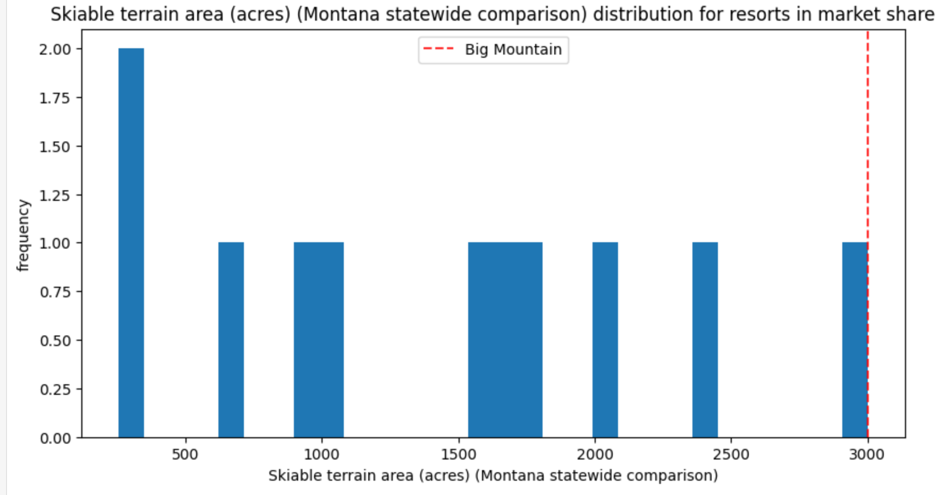
Skiable Terrain Area
A figure showing the skiable area distribution of US resorts
A figure showing the skiable area distribution of Montana resorts
Big Mountain occupies a strong position among all US resorts and leads the pack in Montana.

Slide 6
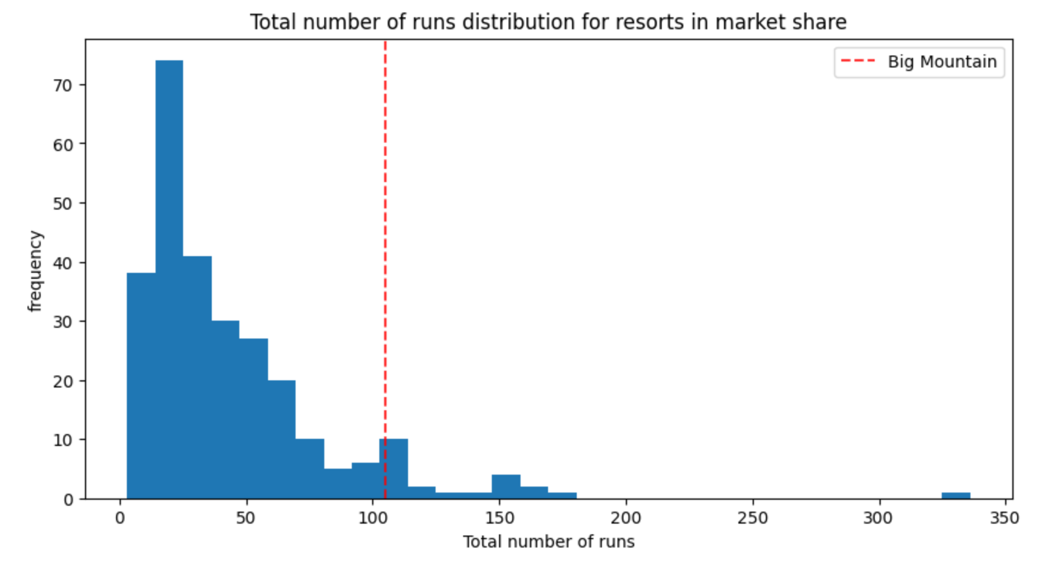
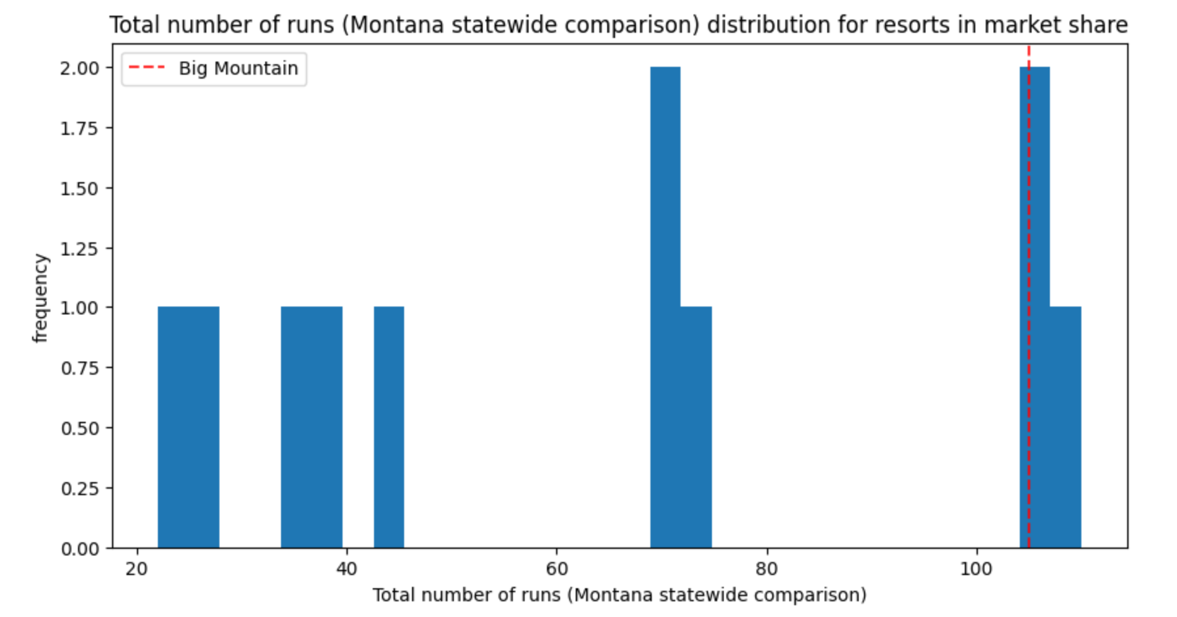
Total Number of Runs
Below shows the total run count of each resort in the US market
Below shows the total run count of each resort in Montana
Big Mountain in both scenarios can be seen well above the mean number of runs a typical resort has.

Slide 7
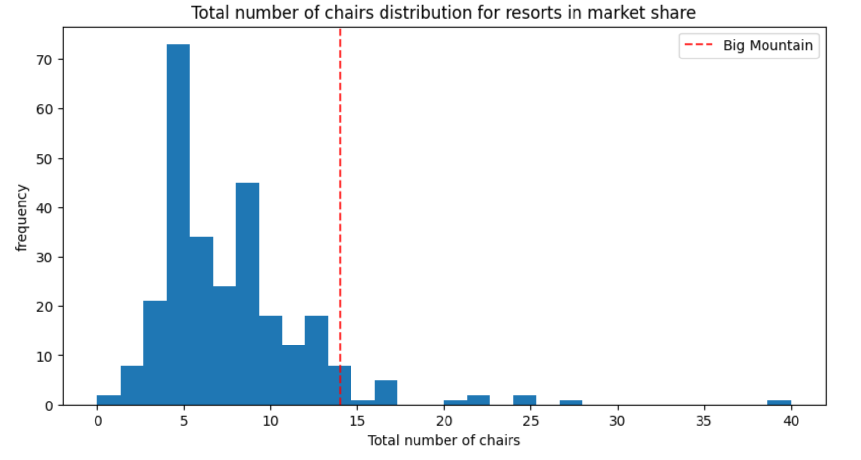
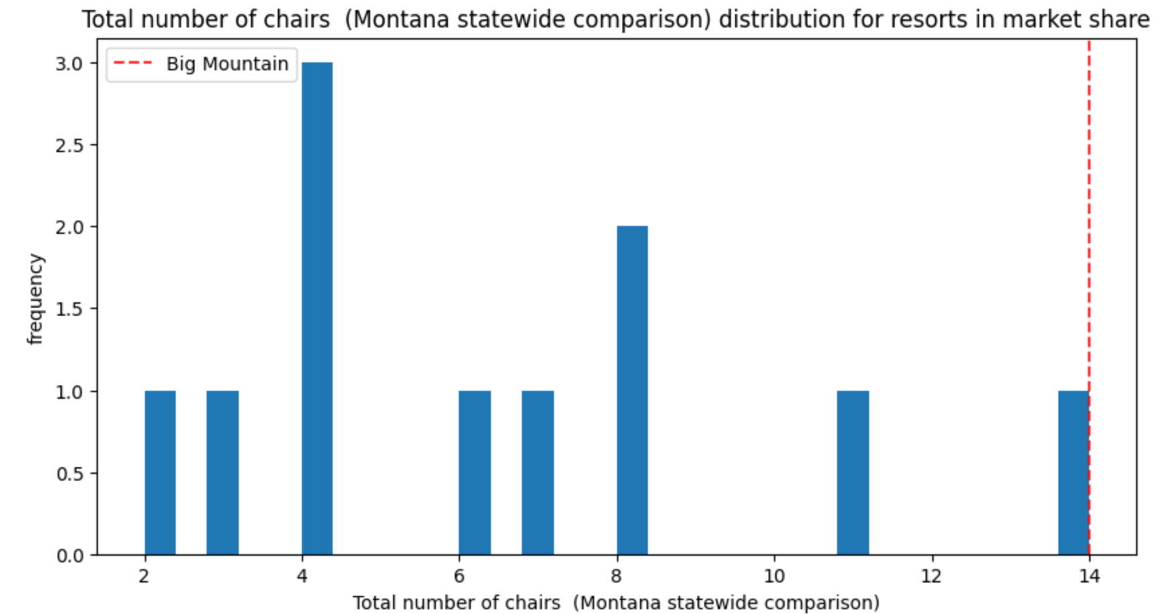
Total Number of Chair Lifts
The total number of chair lifts of each resort in the US
The total number of chair lifts of each resort in Montana
Big Mountain sits comfortably above the mean across US resorts and at the top in the state of Montana.

Slide 8
Additional Findings
Closing down the 5 least popular trails permanently will have a negligible impact on revenue
Increasing the snow production by 2-4 acres will also produce an insignificant change in revenue
Adding a new chair lift and a run that increases the vertical drop of the resort by 150 feet can justify a modest increase in ticket prices

Slide 9

Conclusion:
Increasing the ticket prices by $10.00* can produce an estimate of $17,500,000** in additional revenue.
*The recommended increase from $81.00 → $91.00 was predicted by a random forest regression model
**Based on an estimate of 350,000 visitors to the park over the season, with each visitor skiing an average of 5 days (5 tickets).

